Slide 1
Digestive System
Shivam Singh
Campbell Ch. 41
Ravens Ch. 47

Slide 2
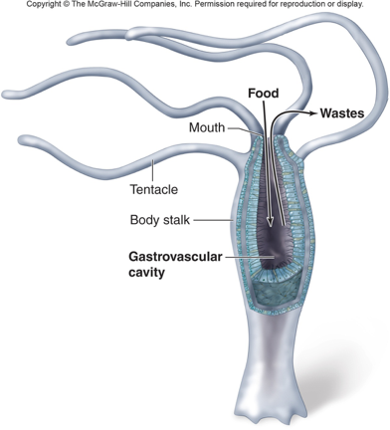
Primitive Systems: Gastrovascular Cavity

Slide 3
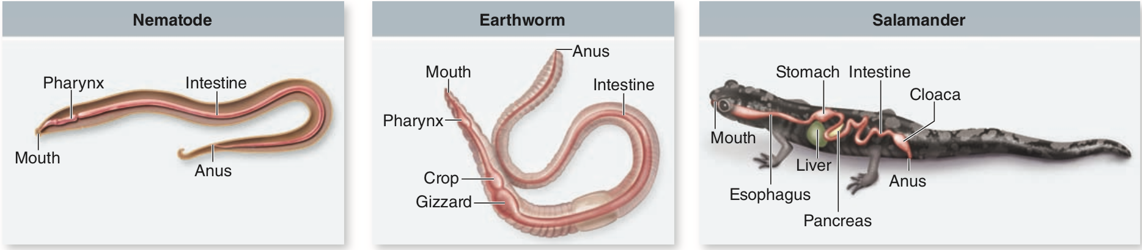
Primitive Systems: Alimentary Canal
Gizzards use pebbles to crush food

Slide 4
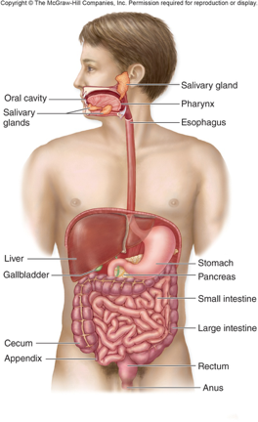
Vertebrate Systems Overview

Slide 5
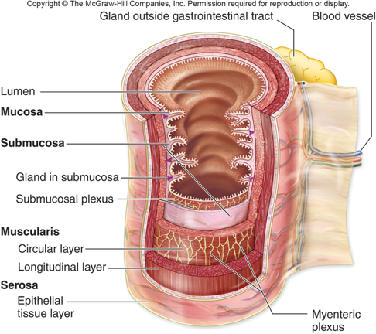
Layers of Gastrointestinal Tract
Submucosa
Connective tissue
Contains submucosal plexus (nervous system)
MORE ON THIS LATER
Circular
Constricts
Myenteric (Auerbach’s) plexus
Longitudinal
Shortens
Notes:
Mucosa is internal lining

Slide 6
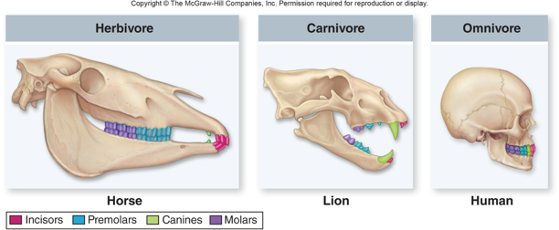
Mastication Adaptation

Slide 7
Swallowing: Key Players
Soft Palate
Voluntary, pushes into pharynx
Pharynx
Back of throat
Pressure causes swallowing REFLEX
Larynx
Raises automatically
Push glottis
Glottis
Pushes epiglottis
Epiglottis
Makes sure you don’t breathe your food
Notes:
Trachea is windpipe

Slide 8
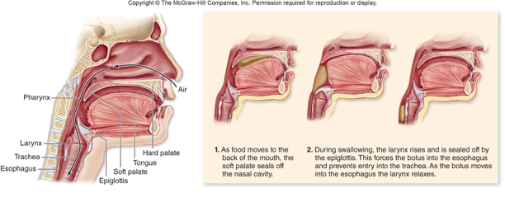

Slide 9
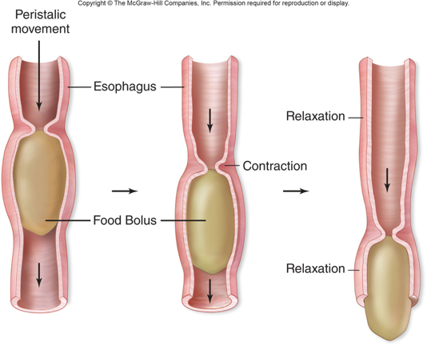
Sphincters
Humans don’t have ‘true’ sphincters

Slide 10
Stomach: NOT THE ENTIRE DIGESTIVE SYSTEM
Small portion
Can expand from 50mL to 2-4L
Has oblique layer (muscularis) to mix food
Secretory system
Chief Cells: Pepsinogen (POSITIVE REINFORCEMENT)
Mucus-Secreting
Parietal: H⁺ + Cl⁻ → HCl
Zymogens, Why??
Notes:
Talk about intrinsic factor in parietal and how it allows B12 absorption → lack of causes anemia

Slide 11
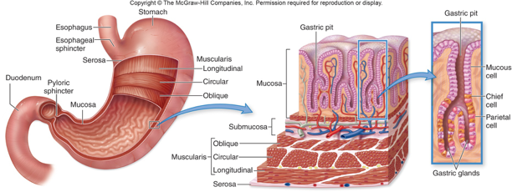

Slide 12
Stomach
Chyme
Combination of acid and food
Acid kills bacteria
Also can cause ulcers
H. Pylori
Pyloric Sphincter
Stomach doesn’t absorb (except aspirin …)

Slide 13
Small Intestine
Duodenum → Jejunum → Ileum
HCO₃⁻ from pancreas (acini cells)
trypsin/chymotrypsin from pancreas (acini)
Bile from gallbladder

Slide 14
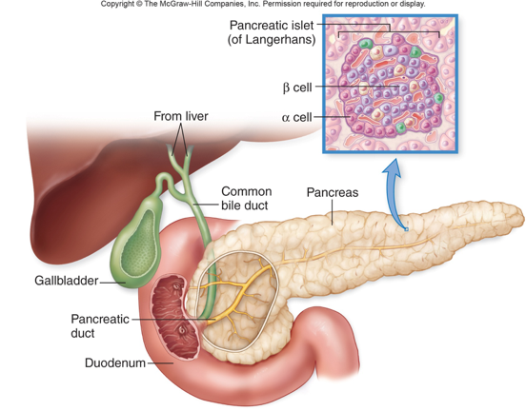

Slide 15
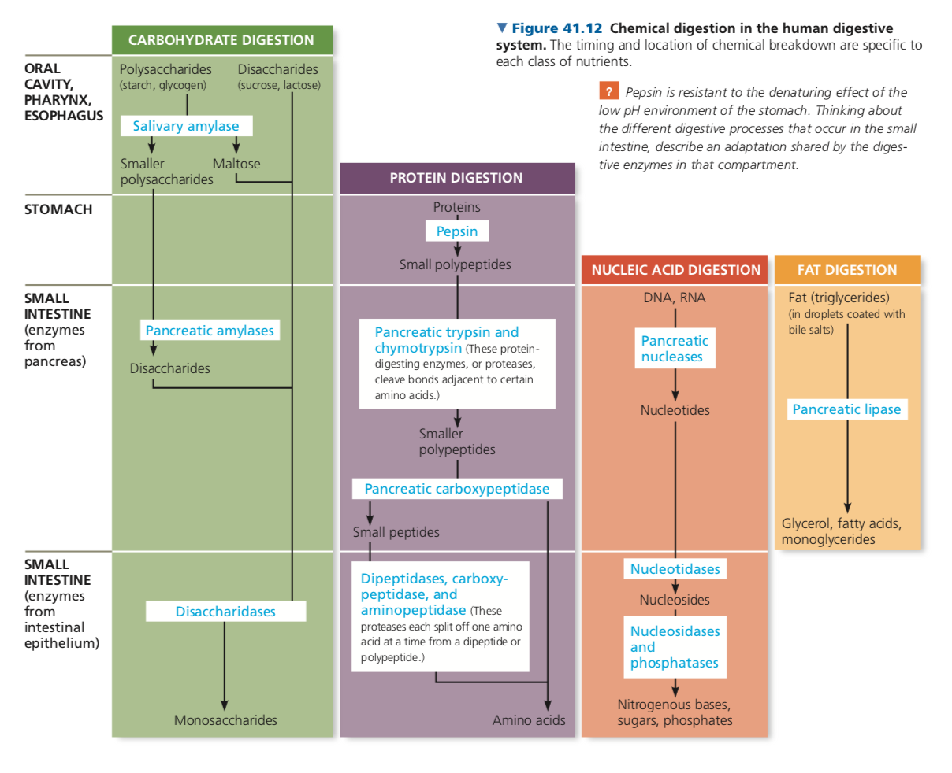

Slide 16
SURFACE AREA Side Note
S.A α S²
while V α S³ so
S.A/V α 1/S (smaller V means you get faster absorption)

Slide 17
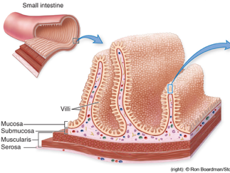
Back to Digestion
Epithelial has villi and microvilli
Microvilli contain brush border (lactose intolerance)

Slide 18
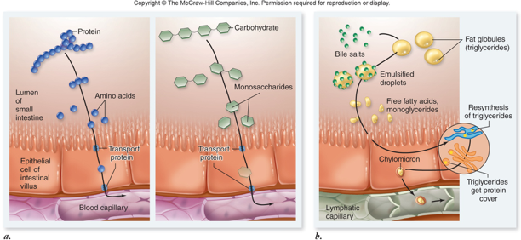
Hepatic Portal Vein

Slide 19
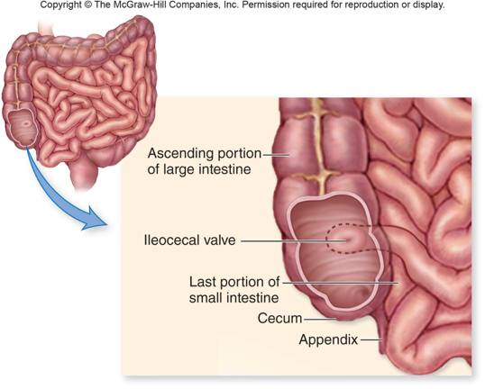
Large Intestine (Colon)
Cecum
Vestigial (bacteria to break cellulose)
Appendix
Vestigial
Ileocecal valve
Sphincter to sep. intestines

Slide 20
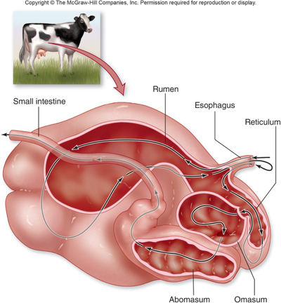
Ruminants (Not so much on open)
Rumen
Fermentation vat
b/c it’s at front, food regurgitated
“Cud”
Omasum and Abomasum
Digest the cellulose

Slide 21
Interesting: Convergent Evolution via Lysozyme
Lemurs and ruminants
Usually, tears (immune)
Now, bacteria in stomach

Slide 22
Vitamin K
Produced by bacteria in ALL mammals
Antibiotic treatment
K supplements

Slide 23
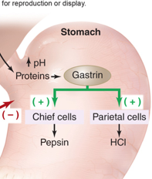
Gastrin
Causes production of HCl via stimulation of Chief and Parietal cells
Negatively regulated

Slide 24
Enterogastrones
Secretin
acidic
CCK
Cholecystokinin
Fat
GIP
Fat

Slide 25
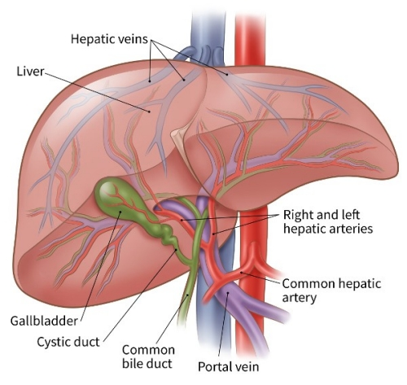
Liver
Filters input from Hepatic Portal Vein
Breaks down toxins (NH₃)
Maintains blood plasma conc.
Edema = fluid buildup in tissue
Blood conc. too low

Slide 26
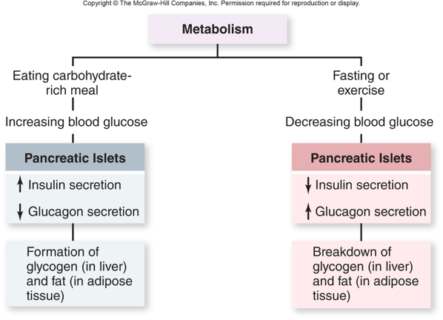
Insulin/Glucagon
Glycogenolysis
Gluconeogenesis
Muscle wasting from fasting

Slide 27
Hunger: Important Players
Leptin
Suppresses hunger
Ghrelin
Increases appetite
Insulin, CCK, GIP
Suppress hunger
Neuropeptides
α-melanocyte-stimulating hormone (high leptin)
Neuropeptide Y (low leptin)

Slide 28
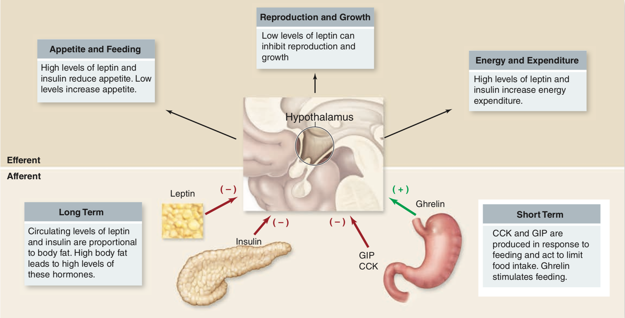

Slide 29
